Slide 1






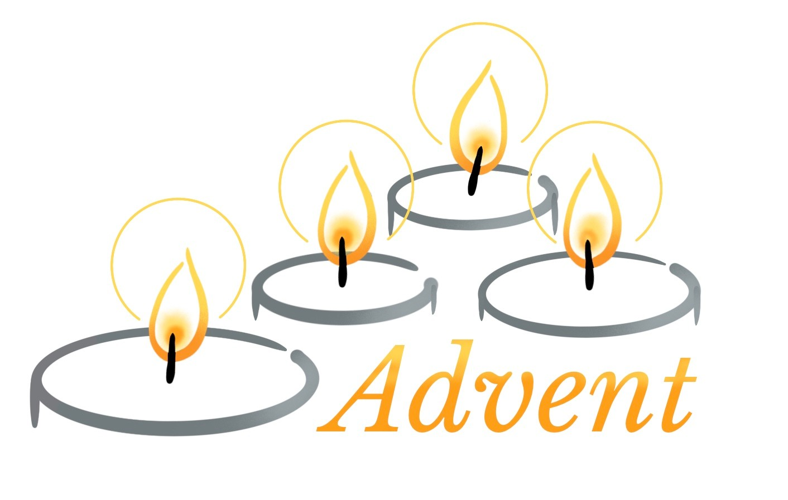









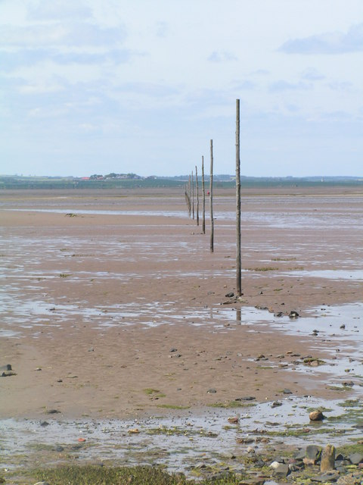

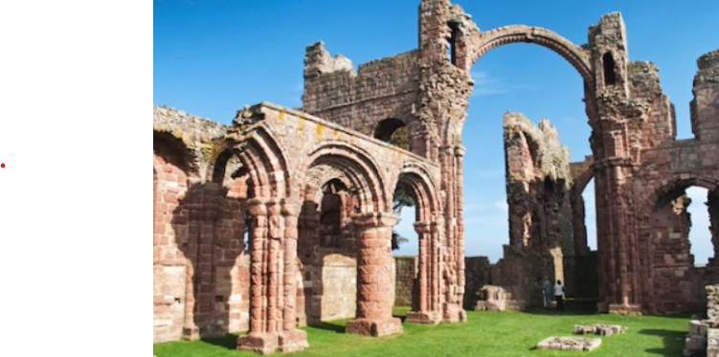
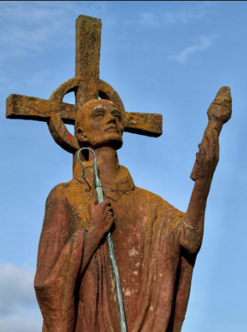
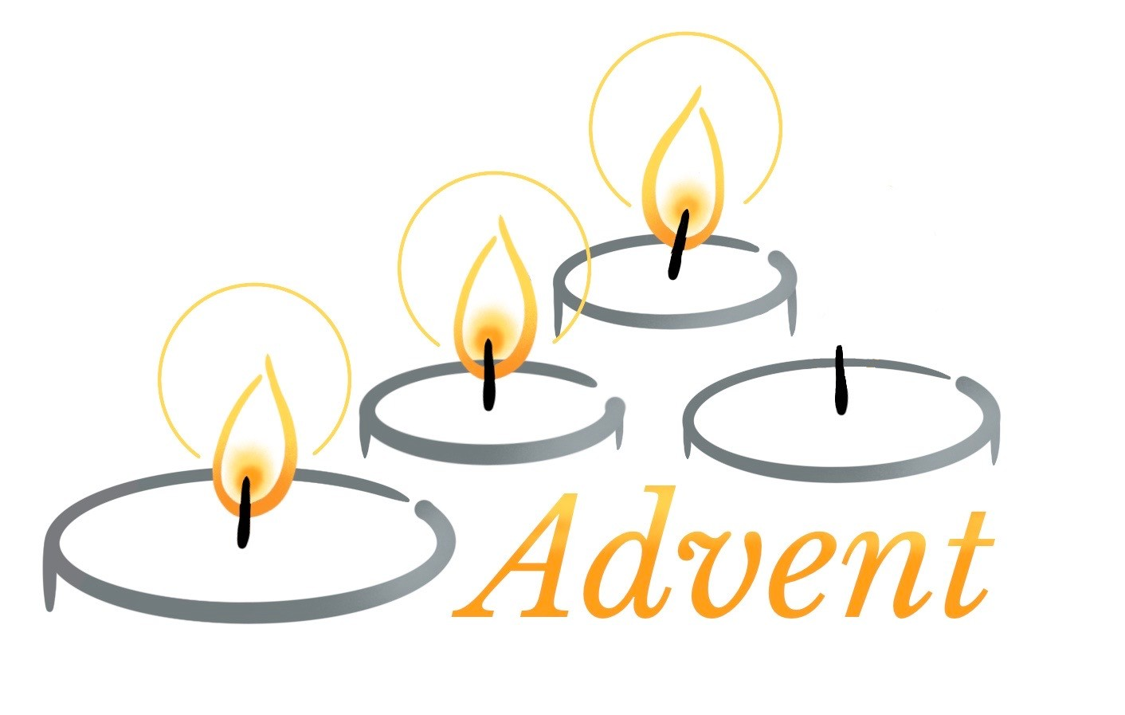



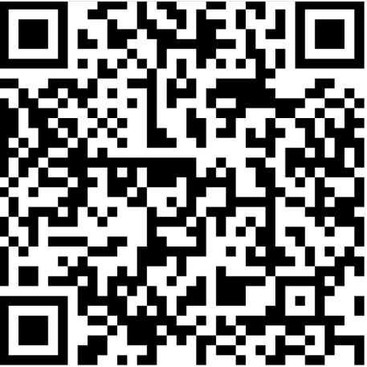


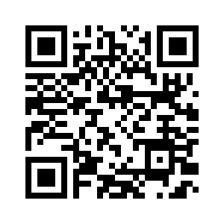



Saturday 12th July
4.00pm – 6.00pm
Seaside/summer theme
Christ Church Community Hall
Christchurch Road
For more details contact:
Tel: Rachel Parker 07988569600
or email rachel.parker@centenaryproject.org.uk
A special welcome today to
Rowan Unwin
Please remember them and their family in your prayers.
Offertory Hymn
I am the Bread of Life;
you who come to me shall not hunger;
you who believe in me shall not thirst,
no-one can come to me
unless the Father draw them.
And I will raise you up,
and I will raise you up,
and I will raise you up on the last day.
The bread that I will give
is my flesh for the life of the world,
and if you eat of this bread,
you shall live forever, you shall live forever!
And I will raise you up …..
Unless you eat
of the flesh of the Son of Man
and drink of his Blood, and drink of his Blood,
you shall not have life within you.
And I will raise you up …..
I am the Resurrection;
I am the Life.
If you believe in me,
even though you die, you shall live forever.
And I will raise you up …..
Yes, Lord, we believe
that you are the Christ,
the Son of God
who has come into the world.
And I will raise you up …
Suzanne Toolan ©️ 1971 by GIA Publications
Used with permission CCLI 283699
It is well with my soul
When peace like a river attendeth my way,
when sorrows like sea billows roll;
whatever my lot, thou hast taught me to say,
‘It is well, it is well with my soul.’
Refrain:
It is well with my soul;
it is well, it is well with my soul.
Though Satan should buffet, if trials should come,
let this blest assurance control:
that Christ has regarded my helpless estate,
and has shed his own blood for my soul. Refrain
For me, be it Christ, be it Christ hence to live’
if Jordan above me shall roll.
No pang shall be mine
for in death as in life
you will whisper your peace to my soul. Refrain
O Lord, haste the day when my faith shall be sight,
the clouds be rolled back as a scroll;
the trump shall resound and the Lord shall descend;
even so, it is well with my soul. Refrain
The Romans Course
This is a 10 session Bible Society course on Paul's letter to the Romans with videos and discussion. The course began on Monday 21st September. Session 3 will be on Monday 19th October at 7.15am for refreshments and 7.30pm start. All welcome!
Welcome
to Christ Church
11th October 2026
The Nineteenth Sunday after Trinity
9.45am Harvest Morning Worship
The Potter’s Hand
Beautiful Lord, wonderful Saviour,
I know for sure
all of my days are held in your hand,
crafted into your perfect plan
You gently call me into your presence,
guiding me by your Holy Spirit.
Teach me, dear Lord, to live all of my life
through your eyes.
I'm captured by your holy calling;
set me apart;
I know you're drawing me to yourself;
lead me Lord, I pray.
Take me, mould me, use me, fill me;
I give my life to the Potter's hand.
Call me, guide me, lead me, walk beside me;
I give my life to the Potter's hand.
Darlene Zschech (1965- )
© Copyright 1997 Hillsong Publishing (ASCP)
CCLI Licence No. 283699
Retreat/Pilgrimage to Lindisfarne
In April 2026 we are hoping to arrange a retreat/Pilgrimage to Holy Island, Lindisfarne.
The cost will be under £200 per person & will be from Monday to Friday.
If you are INTERESTED in coming please inform John Parker ASAP.
Christian Aid Week
If you would like to give to the work of Christian Aid there are envelopes at the back of church. Please return any envelopes as soon as possible. Thank you
Ruth Sunderland
The Feast of the Presentation
Today we celebrate the Feast of the Presentation of Christ in the Jerusalem Temple – the feast is actually on February 2nd, forty days (inclusive) after Christmas Day.
Today’s gospel tells the encounter of the young child Jesus and his parents with Simeon and Anna.
Simeon immediately recognises Jesus as the Messiah who they have waited for a long time. Because of this he says he is now ready to die, saying the now familiar words of the Nunc Dimittis, a favourite canticle for Evening Prayer:
Now, Lord, you let your servant go in peace:
your word has been fulfilled.
My own eyes have seen the salvation
which you have prepared in the sight of every people;
A light to reveal you to the nations
and the glory of your people Israel.
Luke 2:29–32
Anna began to praise God and spoke of the long awaited child and the work of redemption of all people to which he is called.
After they had finished everything required by the law of the Lord, they go back home to Nazareth.
CCLI number
1277288
Wath 1222257.
Pass it on
It only takes a spark to get a fire going,
and soon all those around can warm up in its glowing;
that’s how it is with God’s love,
once you’ve experienced it:
you spread His love to everyone;
you want to pass it on.
What a wondrous time is spring when all the trees are budding,
the birds begin to sing; the flowers start their blooming;
that’s how it is with God’s love,
once you’ve experienced it
you want to sing, it’s fresh like spring;
you want to pass it on.
I wish for you, my friend, this happiness that I’ve found;
you can depend on Him, it matters not where you’re bound;
I’ll shout it from the mountaintop,
I want my world to know; The Lord of love has come to me,
I want to pass it on.
Kurt Kaiser
©️ 1969 Bud John Songs/Alliance Media Ltd/CopyCare Ltd
Printed with permission: CCLI licence no. 283699
Children in Distress Shoebox Appeal
We will be sending shoeboxes once again. Please try to collect a shoebox of your own. Take a leaflet from the back of church.
Cover the box with Christmas wrapping paper. Fill it with appropriate items and include £3 for postage.
Bring the box back to church on or before November 1st.
The boxes will be collected on November 1st.
Alternatively you can put items into the box provided in Friendship Area.
Thank you
The Diocesan Vision Prayer
Living God,
Jesus calls his followers to seek first your Kingdom.
Renew us as we make your love known;
Release us to share freely together in mission;
And Rejuvenate us to be fruitful in your service.
Give us courage, wisdom and compassion,
that strengthened with the grace of the Holy Spirit,
we may, as the Diocese of Sheffield, both flourish
and grow through Christ Our Lord.
Amen
We’re excited to launch our new website for Brampton and Wath church.
On 6th January we celebrate Epiphany – the visit of the Wise Men to the baby Jesus. But who were these Wise Men? No one knows for sure. Matthew calls them ‘Magi’, and that was the name of an ancient caste of a priestly kind from Persia. It wasn’t until the third century that they were called kings – by a church father, Tertullian.
Another church father, Origin, assumed there were three – to correspond with the gifts given. Later Christian interpretation came to understand gold as a symbol of wisdom and wealth, incense as a symbol of worship and sacrifice, and myrrh as a symbol of healing – and even embalming. Certainly Jesus challenged and set aright the way in which the world handled all three of these things. Since the 8th century, the Magi have had the names Balthasar, Caspar and Melchior.
Recessional Hymn
Jubilate, everybody,
serve the Lord in all your ways,
and come before His presence singing,
enter now His courts with praise.
For the Lord our God is gracious,
and His mercy's everlasting.
Jubilate, Jubilate,
Jubilate, Deo.
From Psalm 100, Fred Dunn ©️ 1977, 1980 Kingsway’s Thankyou Music
Printed with permission: CCLI licence no. 283699
This Week’s Diary
(all at Christ Church unless stated)
Tuesday 13th October
10.00am Holy Communion followed by refreshments and prayer
4.00pm Social committee meeting All Saints Wath
Wednesday 14th September
10.00am to 12.00 noon
CHURCH OPEN – ALL ARE WELCOME!
Thursday 15th October
9.30am Matins All Saints Wath
1.00pm Fellowship Group
Sunday 18th October
9.45am Holy Communion
For more information see our website at www.wathwithbramptonparish.org.uk
or visit our Facebook page – Wath with Brampton Parish
Hymn during Communion
When we're gathered in the Spirit
It's a promise that He gives us
When we gather in His name
There's a love we feel in Jesus
There's a manna that He feeds us
It's a promise that He gives us
When we gather in His name
And we know when we're together
Sharing love and understanding
That our brothers and our sisters
Feel the oneness that He brings
Thank You, thank You, thank You, Jesus
For the way You love and feed us
For the many ways You lead us
Thank You, thank You, Lord
Tedd Smith Words © 1973 Hope Publishing Company
Printed with permission: CCLI licence no. 283699
A special welcome today to
Jett Samuels
Lenny Luke Williams
Please remember them and their families in your prayers.
Songs of Praise
There will be a Parish Songs of Praise Service at Christ Church on Sunday 25th October at 4.00pm.
Come along and sing the favourite hymns of some of our congregation.
Hymn during Communion
Fairest Lord Jesus, Ruler of all nature,
O thou of God and man the son
Thee will I cherish, Thee will I honour;
Thou my soul’s glory, joy and crown.
Fair are the meadows, fairer still the woodlands
robed in the verdure and bloom of spring.
Jesus is fairer, Jesus is purer;
He makes the saddest heart to sing.
Fair is the sunshine, fairer still the moonlight
and fair the twinkling starry host.
Jesus shines brighter, Jesus shines purer
than all the stars that heaven can boast.
All fairest beauty, heavenly and earthly,
wondrously, Jesus, is found in thee.
None can be nearer, fairer, or dearer
than thou, my Saviour, art to me.
Beautiful Saviour, Lord of the nations,
Son of God and Son of Man!
Glory and honour, praise, adoration
now and for evermore be Thine.
In the Public Domain
Gaudete – Rejoice – Sunday
Advent 3, half way through Advent, is often known in the calendar of the Western Church
as ‘GAUDETE SUNDAY’ or ‘REJOICE SUNDAY’
from the Latin ‘Gaudete in Domino semper’:
Rejoice in the Lord always
(Philippians 4:4-5)
so we light the rose candle to lighten things a little.
We’ll light the last purple candle on the last Sunday
of Advent as the penitential season draws to a close and Christmas draws nearer and nearer when the white candle will be lit symbolising the coming of the Christ into our world.
It’s interesting to remember that, just as during Advent we’re preparing spiritually for the full joy of Christmas, similarly during Lent, when purple appears in church again, we’re preparing spiritually for the full joy of Easter. Just over mid-way through Lent (always on Lent 4) we have Mothering Sunday (also known as Laetare or Refreshment Sunday) which provides a more light-hearted, celebratory time during the more solemn time of Lent.
God of mission,
Who alone brings growth to your church,
Send your Holy Spirit to give
Vision to our planning,
Wisdom to our actions,
Joy to our worship,
And power to our witness.
Help our church to grow in numbers,
In spiritual commitment to you,
And in service to our local community,
Through Jesus Christ our Lord.
Amen.
Giving
Harvest Lunch
Sunday 11th October
12.30pm
St James’ Room Wath
Pie and peas with dessert
Tickets £6 adult £3 child
Available from Dorothy or Ann
Jigsaw
Puzzle
Library
Gradual Hymn
A new commandment I give unto you,
that you love one another as I have loved you,
that you love one another as I have loved you.
By this shall all know that you are My disciples,
if you have love one for another;
by this shall all know that you are My disciples:
if you have love one for another.
©️ Roy Crabtree/CopyCare Ltd
Printed with permission: CCLI licence no. 283699
These can be borrowed/returned at Coffee Mornings (donation welcome). For more info contact Andrea Burton 07771871966
God of mission,
Who alone brings growth to your church,
Send your Holy Spirit to give
Vision to our planning,
Wisdom to our actions,
Joy to our worship,
And power to our witness.
Help our church to grow in numbers,
In spiritual commitment to you,
And in service to our local community,
Through Jesus Christ our Lord.
Amen.
Prayer for Healing
During the distribution of communion, we are offering prayer for healing. If you would like prayer for anything, please come and sit near the Book of
Remembrance, and we will pray with you.
If you would like to support the work of CMS this Lent then please take a box or envelope from the table at the back and return them on Easter Sunday or soon after.
Thank you
Barbara Sunderland
Jigsaw
Puzzle
Library
If you would like to donate to the work of Christ Church then if you scan the code it will take you to our Parish Giving Scheme site where you can make a donation online. Thank you
Safeguarding
Christ Church takes safeguarding of children and
vulnerable adults seriously and has policies for both.
If you have a safeguarding concern about a child or an adult you should contact Ruth Sunderland, the Parish Safeguarding Adviser
More information is on the porch noticeboard.
If you had a box or an envelope during Lent or would like to donate towards the work of CMS then please could you return them as soon as possible.
Thank you Barbara Sunderland
Gift Day
Many thanks to all who contributed to the life of the Parish on our gift day. A total of £4500 was donated across the parish.
These can be borrowed/returned at Coffee Mornings (donation welcome). For more info contact Andrea Burton 07771871966
Please take this sheet home
If you have anything you would like to be included on the notice sheet then please email it to gbrsund@aol.com by Thursday evening if possible.

